Slide 1
Group Software Project
Rían Woods: 117907352
Hoang Anh Mai: 117101156
Adam O’Brien: 117385301
Anthony Flavin: 117375733

Slide 2

UNIPAPERS

Slide 3
Outline
1.Project overview
2.How to signup and login
3. Uploading and Discussion
4. Online Viewing and Answers
5.Conclusion

Slide 4
Unipapers – An overview
We wanted to create a place:
-With a simple and easy-to-use interface.
-Where you can find past papers relevant to you.
-Where you can find solutions to these papers.
-Where you can offer your own solutions to help others.

Slide 5



INSPIRATION
Stack Overflow
Study Clix
UCC Online Library

Slide 6
What we used
HTML and CSS for front-end.
JavaScript and PHP for back-end.
GitHub for version control.

Slide 7
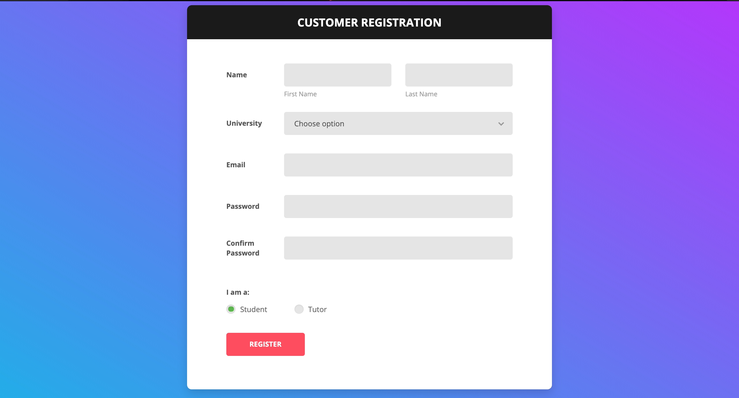
Signup

Slide 8
signup
Validation:
- All required fields filled.
- Check email to match chosen university.
- Check if email is registered.
- Check for password strength and matching password.

Slide 9
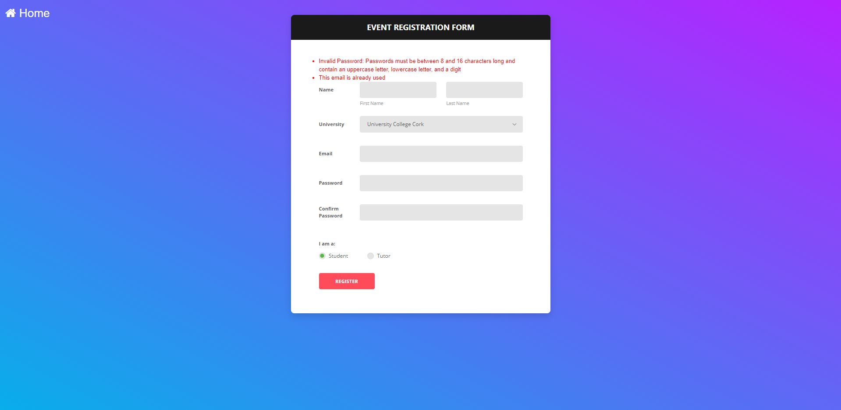
Sample error message

Slide 10
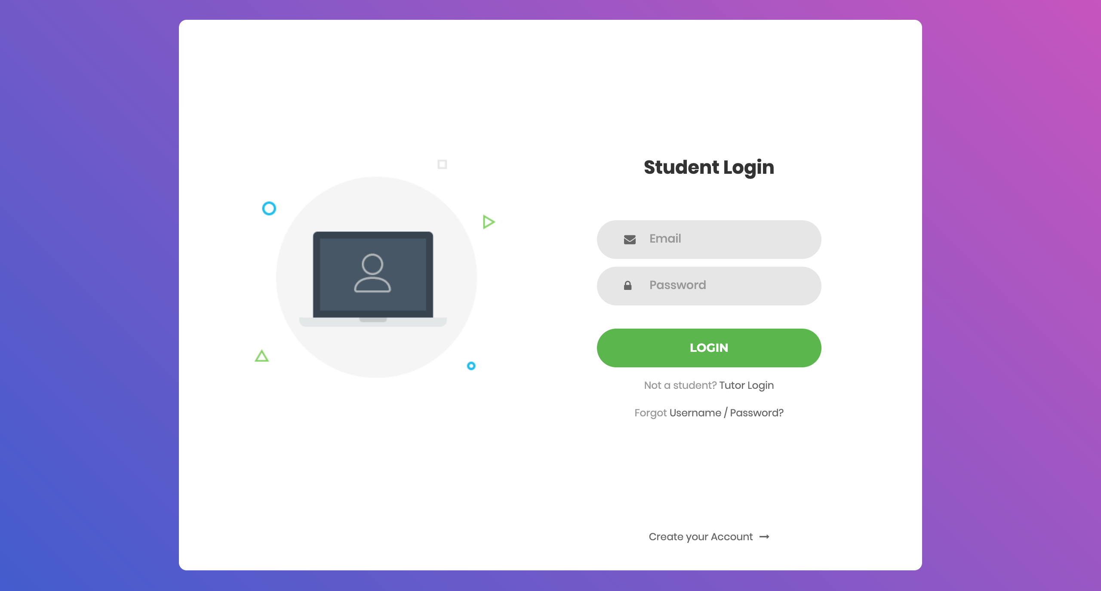
Login

Slide 11
Login
Validation:
-Check if email exist in users database.
-Check if hashed password match hashed password in database.
Leads to:
-If Student Account:
-College Home page
-If Tutor Account:
-Upload Page

Slide 12

Uploading files
Uploading reserved for Tutors.
-Students cannot upload papers.
-To ensure reliability.
Login as a Tutor, will lead you directly to the upload page.
Tutors can only upload to the page of the college they are registered with.

Slide 13

Discussion Page
Users have the option to open a new discussion.
-On a topic of their choosing.
Users can view all discussions.
Each discussion heading can be commented on.
-And each comment can be replied to.
By submission, users will be able to upvote and downvote comments that offer solutions based on their correctness or usefulness.

Slide 14
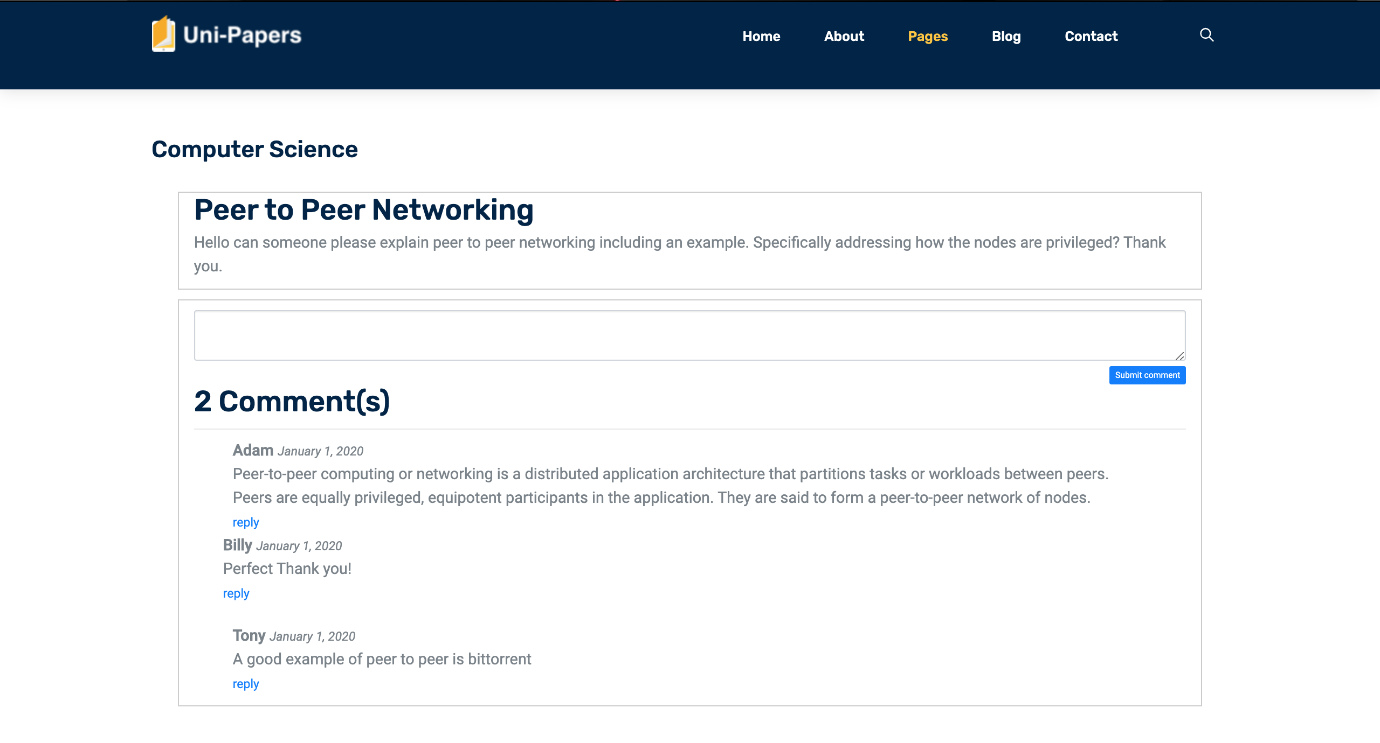
Discussion Page – Example

Slide 15

Online viewing papers
Users select a paper from the module page and it is displayed in a new tab.
Alongside the paper, any answers submitted previously for any questions are displayed.
-For ease of use.

Slide 16
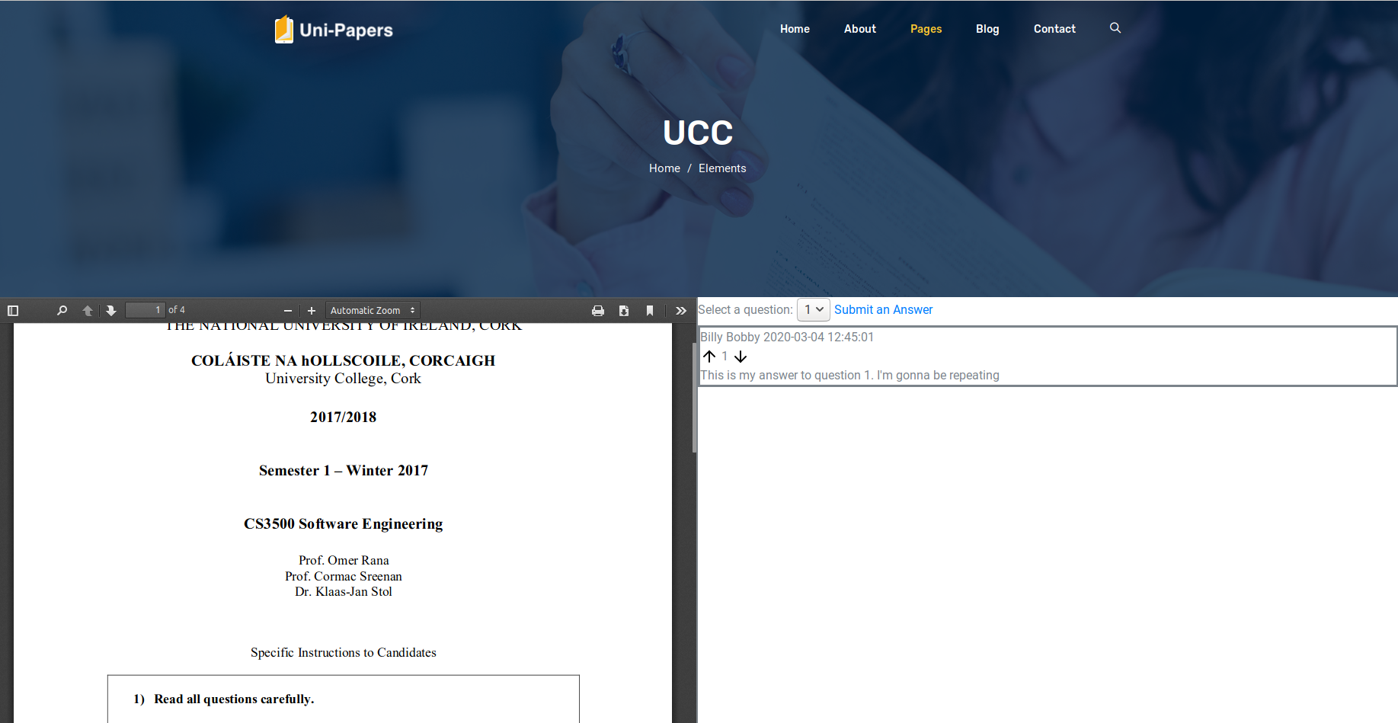
Online viewing papers

Slide 17
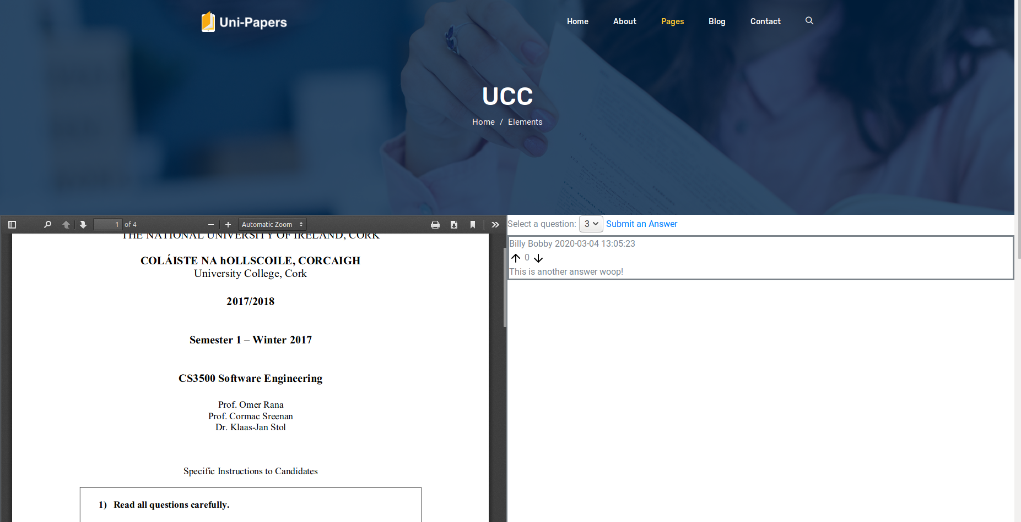
Online viewing papers

Slide 18
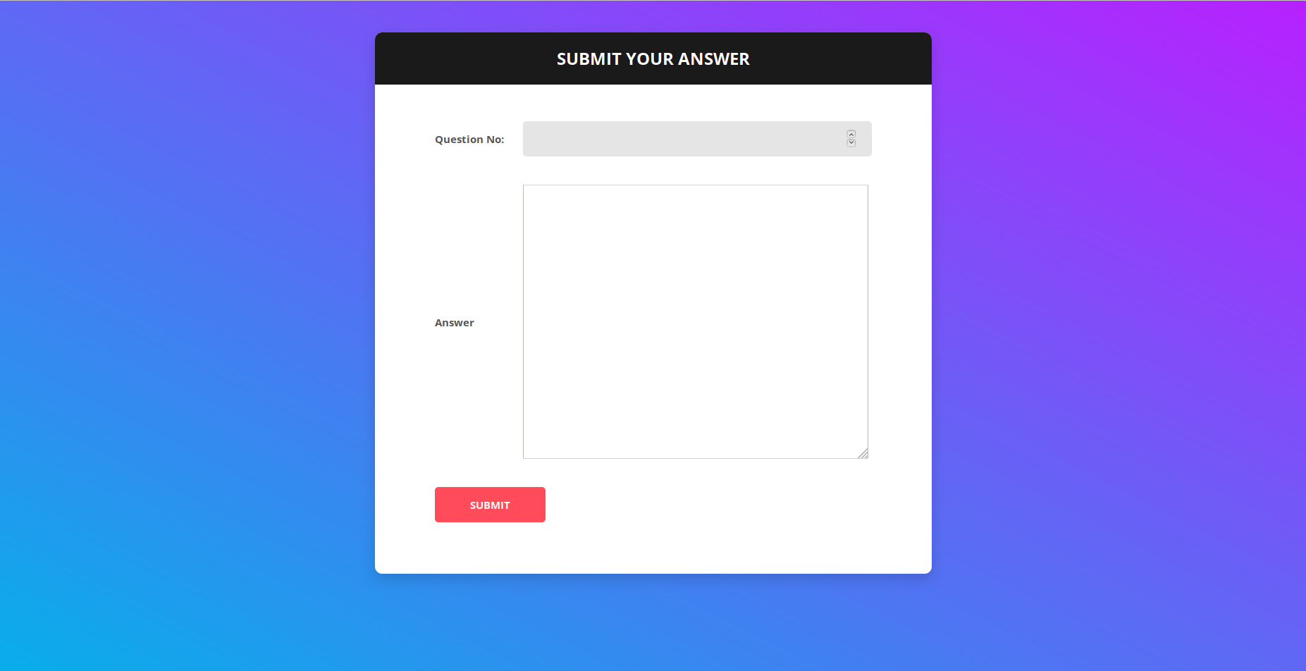

Submitting answers
Select question within paper.
Fill out text.
Submit
EASY.

Slide 19
Upvote and downvote
(Stack Overflow steal)
Users able to upvote or downvote each answer once reviewed.
Gives users confidence in the reliability and correctness of answers.

Slide 20

THANKS FOR LISTENING
Any Questions?

